Slide 1
ALBERTA: CANADA’S CLINICAL TRIAL DESTINATION
Notes:
Image source: https://as1.ftcdn.net/jpg/01/66/48/06/1000_F_166480609_JY2T2E25l7k7HoyT7PvS65iILCqfydE7.jpg

Slide 2
FROM FUNDING TO COMMERCIALIZATION, WE ARE ALBERTA’S INNOVATION ENGINE
Notes:
Image source: https://as1.ftcdn.net/jpg/01/66/48/06/1000_F_166480609_JY2T2E25l7k7HoyT7PvS65iILCqfydE7.jpg

Slide 3
WHO WE ARE

Slide 4
WHO WE ARE
A collaboration between academic, government, and healthcare delivery organizations

Slide 5
WHAT WE DO
Attracting industry research and investment
Enabling high-quality clinical trials and health research
Providing centralized access for industry and researchers

Slide 6
WHY ALBERTA?
Post-Secondary Institutions
Healthcare Delivery Service Providers
Highly integrated clinical trial ecosystem
Government

Slide 7
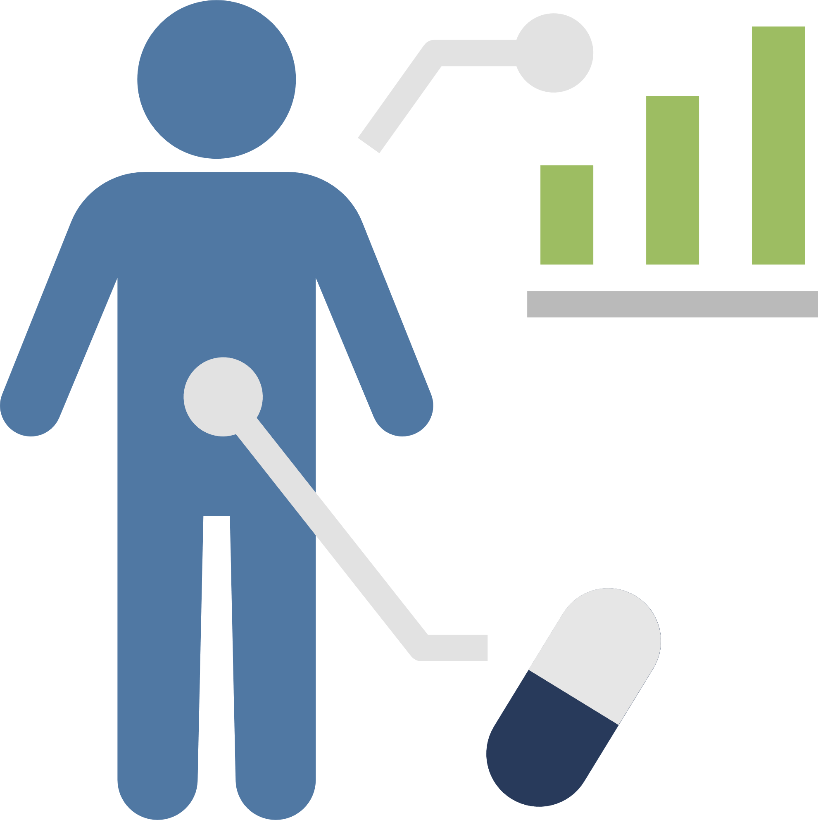
WHY ALBERTA?
2,000+
Active Clinical Trials
4.9 Million
Diverse Individuals
Multiple Phase 1-4 Clinical Trial Units

Slide 8
WHY ALBERTA?
World-class Research Hubs
Real-world Evidence Resources & Capabilities
Diverse Public & Private Sites

Slide 9
WHY ALBERTA?
Extensive population-level health system data assets
Global leader in real-world evidence generation
World-renowned research expertise

Slide 10
PROVINCE-WIDE EMR: FOR HOSPITAL BASED CARE
Central access point for complete, up-to-date patient information
Growing in clinical data by 100GB per day
Empowers impactful real-world evidence studies

Slide 11
Engaged and Ready Patients
PATIENT ENGAGEMENT
Be the Cure
Find a Study
Participate in Research
Find a Clinical Trial
Connect Care EMR

Slide 12
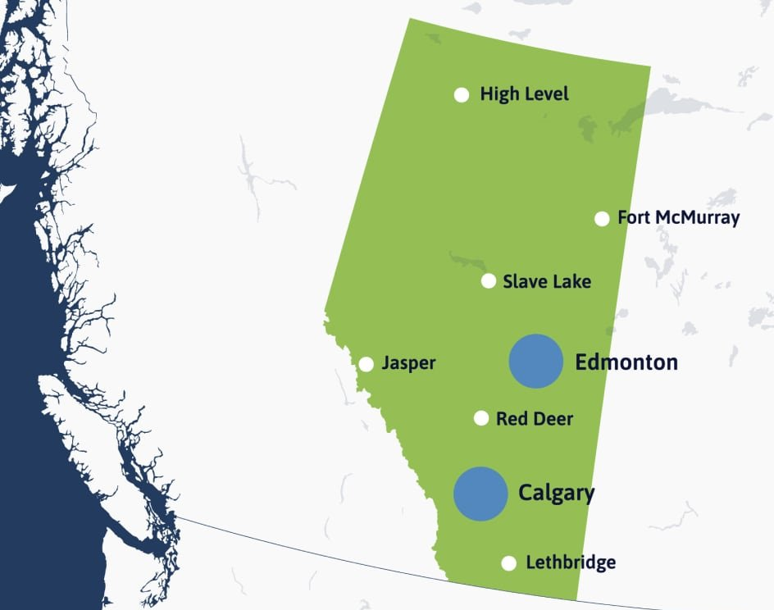
PROVINCE-WIDE TRIAL CAPACITY
Broad research activity across urban and rural communities

Slide 13
ROBUST INNOVATION ECOSYSTEM

Slide 14
RESEARCH EXCELLENCE

Slide 15
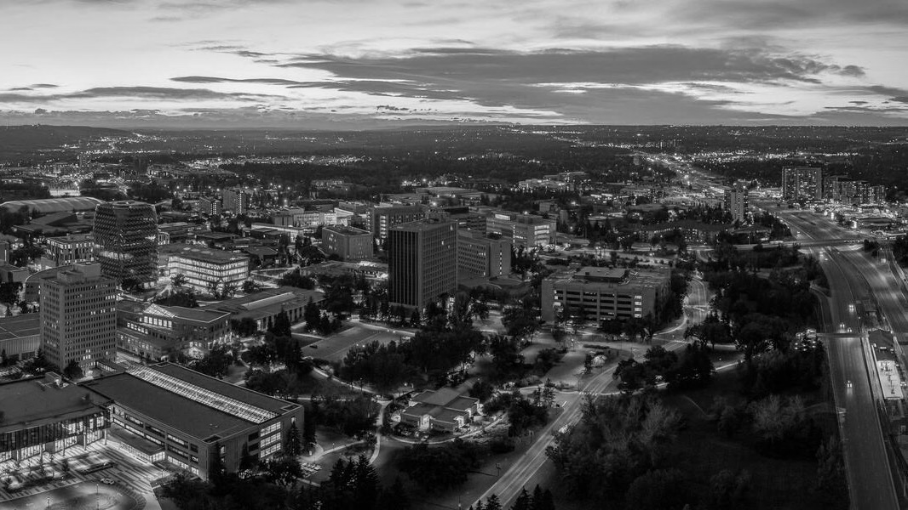
PEDIATRIC & RARE DISEASE LEADERSHIP
Caring for people with rare metabolic and genetic diseases
Transforming the health and well-being of children and families

Slide 16
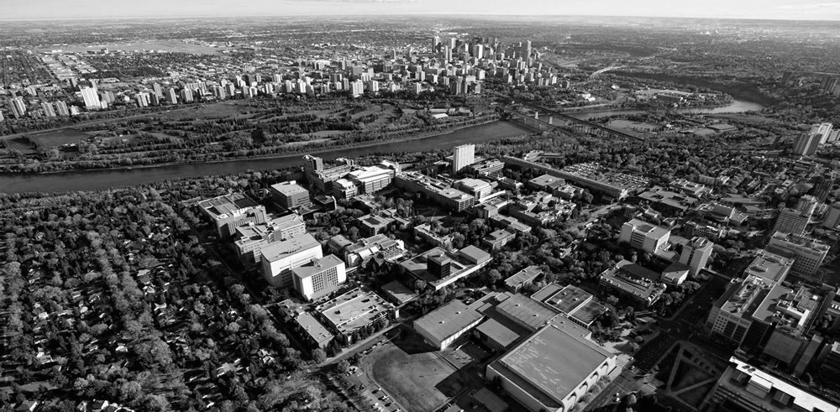
STRENGTH IN CARDIOLOGY & NEUROLOGY
Canadian VIGOUR Centre
Bridging Hearts and Minds
Novel diagnostic and therapeutic strategies in cardiovascular medicine
Connecting cardiovascular research, patient care & education
Innovation in acute stroke diagnosis and treatment

Slide 17
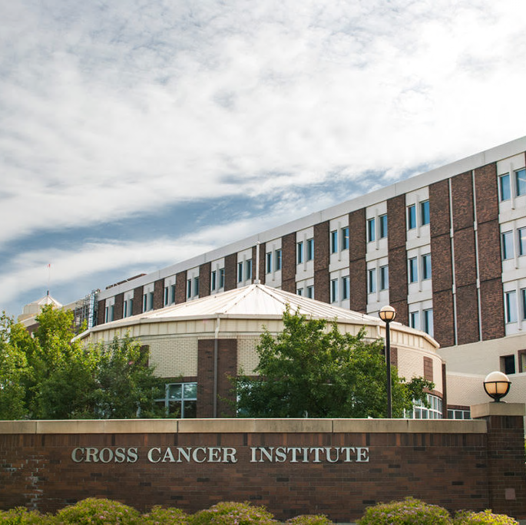
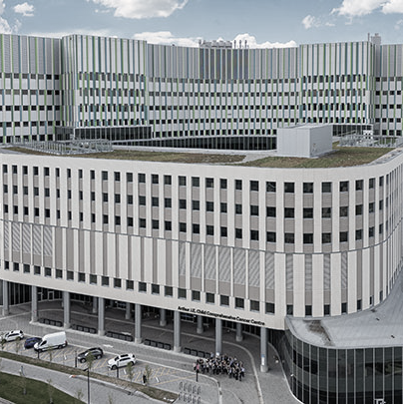
EXPERTISE IN ONCOLOGY
Arthur J.E. Child Comprehensive Cancer Centre
Cross Cancer Institute
Canada’s largest cancer treatment and research facility and 2nd largest in North America

Slide 18
ACTIVE COMMUNITY CLINICAL TRIALS
Connecting the community to clinical trials
Contributing to the future of medical innovation
Conducting research into the prevention, treatment and rehabilitation of musculoskeletal injuries

Slide 19
ALBERTA CLINICAL TRIAL ACTIVITY

Slide 20
DIVERSE TRIAL PORTFOLIOS
Phase I
14%
Phase II
26%
Phase III
47%
Phase IV
12%
~60% of trials industry sponsored

Slide 21
Gastroenterology
Neurology
Oncology
Cardiology
Hematology
TOP THERAPEUTIC AREAS

Slide 22
Commitment to inclusivity and access
Culturally informed outreach and design
EQUITY IN RESEARCH
Engagement with underserved and diverse communities

Slide 23
Real-World Evidence, Real-World Outcomes
Data that Drives Better Care
Transforming Research into Real-Life Impact

Slide 24
READY TO LAUNCH YOUR NEXT TRIAL?
info@clinicaltrialsab.ca
780-991-0297
https://clinicaltrialsab.ca/

